Slide 1
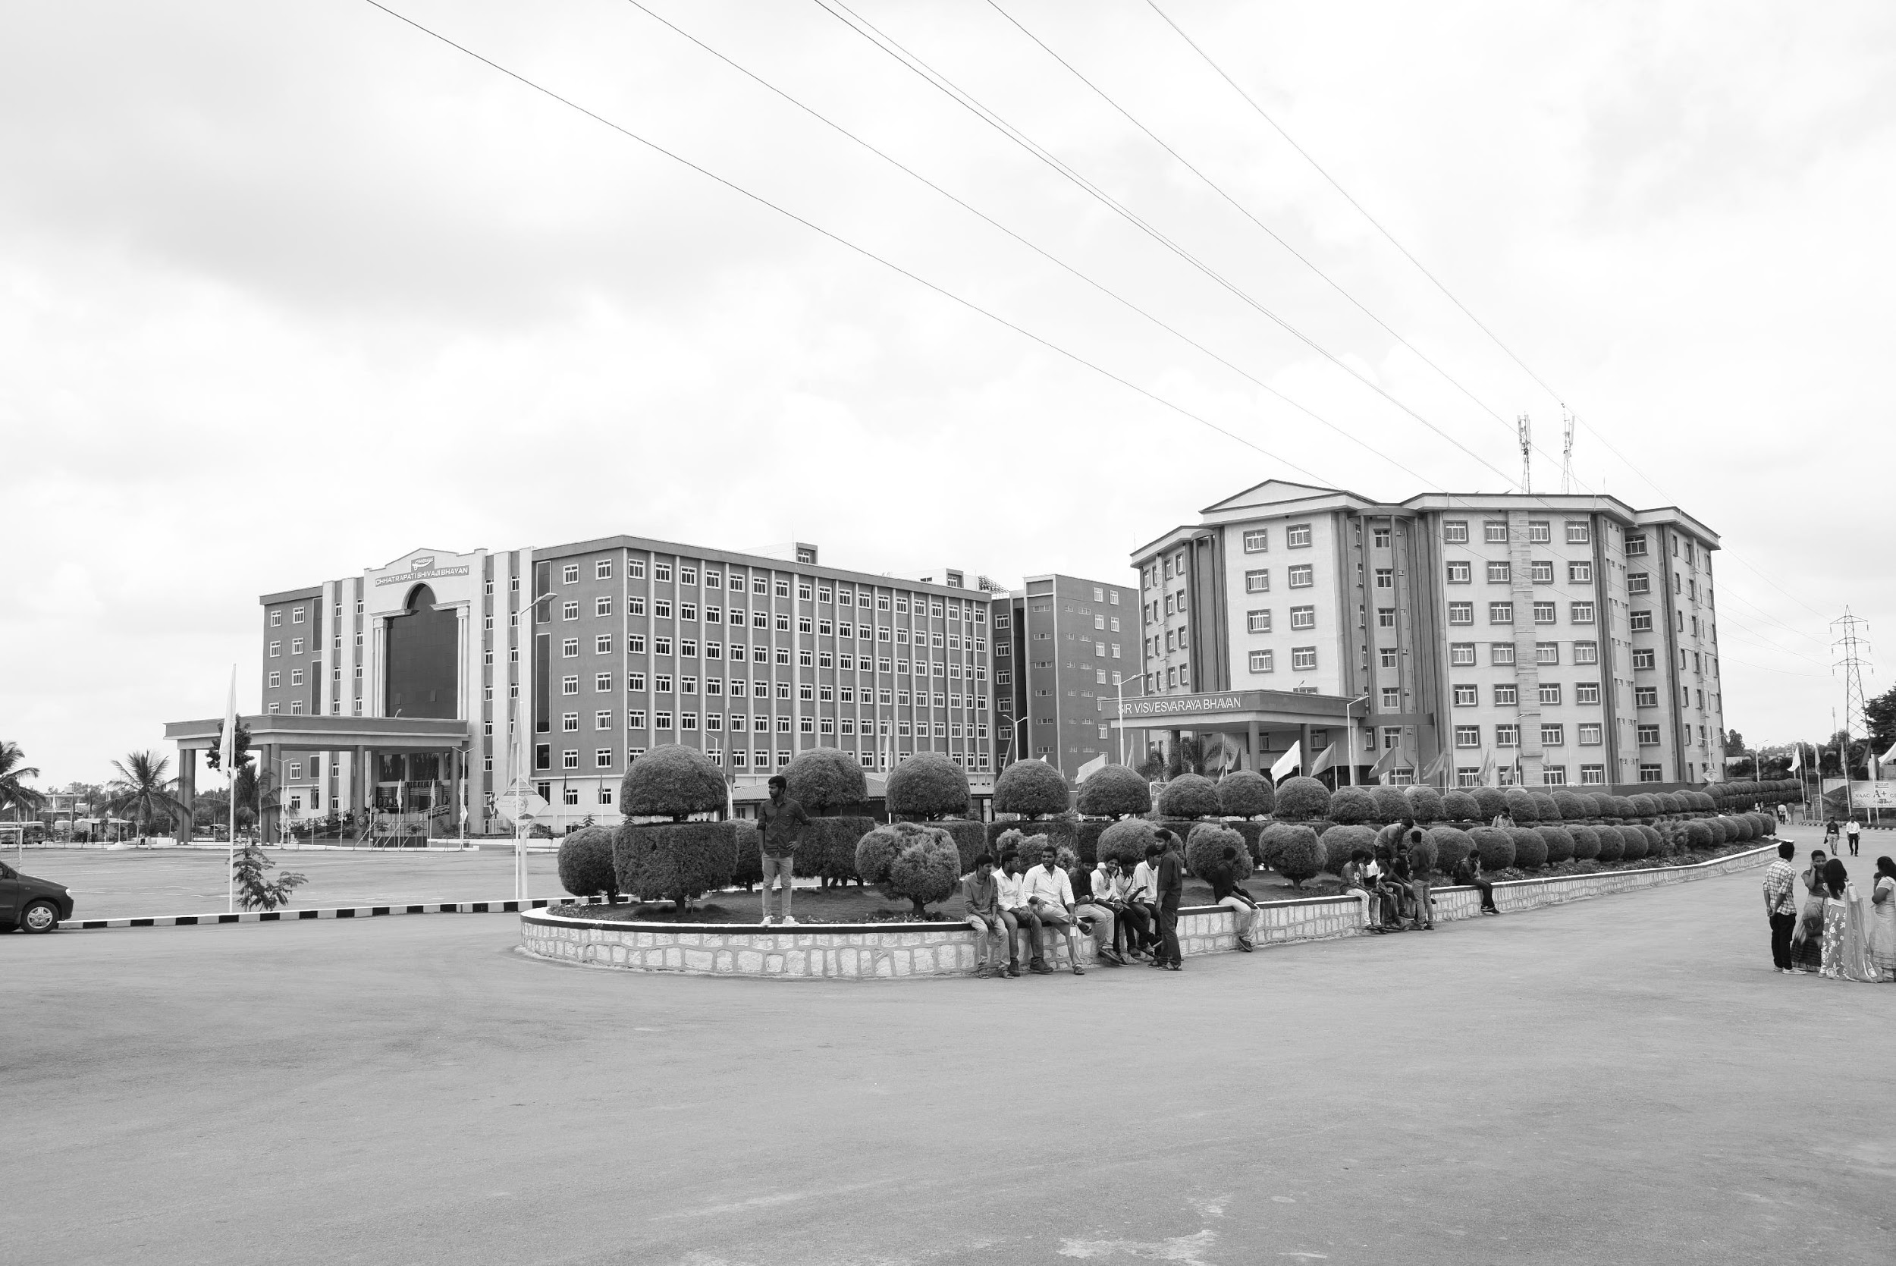

Surface EMG Based Hand Gesture Signal Classification Using CNN for Control Of Software Robot
AY 2021-25
GITAM UNIVERSITY
Major Project
Project ID: CS6
A University should be a place of light, of liberty, and of learning.
Department of Electrical Electronics and Communication Engineering
Project Team:
Avula Veera Siva Reddy
Boya Rajesh
Bhanu Siva Sai Kumar M
Project Mentor:
Dr. Jaya Prakash Sahoo
www.gitamedu.com

Slide 2



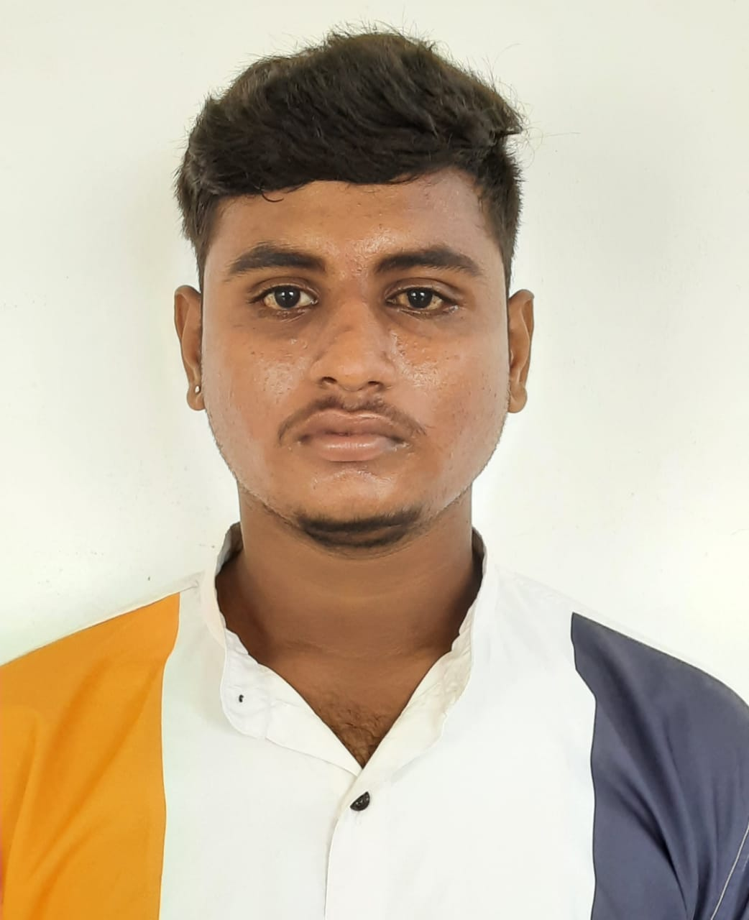
Project Group – Details
Photo
Track
Roll No
Name
EECE
BU21EECE0100393
Avula Veera Siva Reddy
EECE
BU21EECE0100482
Boya Rajesh
EECE
BU21EECE0100331
Bhanu Siva Sai Kumar M

Slide 3
Objective and Goals
Objective
To develop a hand gesture recognition model using surface EMG signals to control a software designed robot.
Goals
Main Goals :
Design an accurate hand gesture recognition model using automatic feature extraction and classification technique like CNN with attention mechanism.
Develop a software robot whose moment will be controlled using developed hand gesture recognition model.
Additional Goals:
To create a dataset using surface EMG sensor.
Analysis of hand gesture model performance with the proposed method.

Slide 4
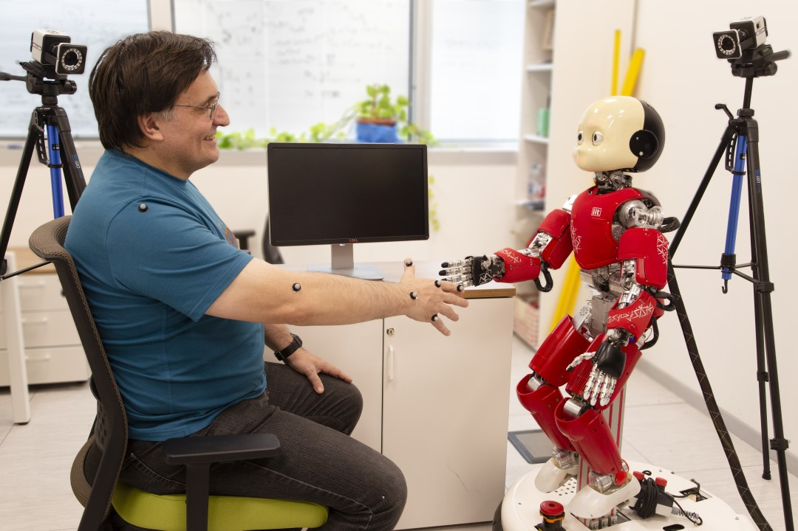
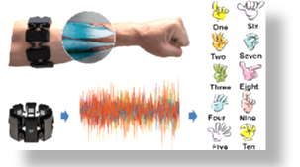


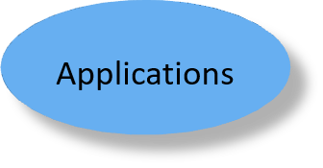

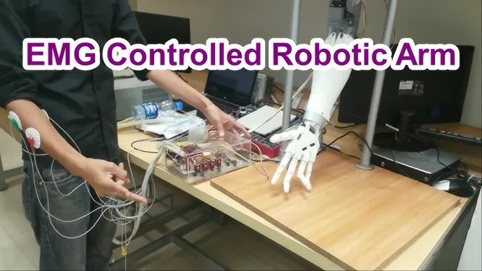
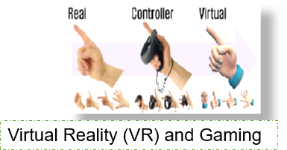
Applications of sEMG
Sign language recognition
Human machine interaction
EMG Controlled Robotic Arm
Virtual Reality (VR) and Gaming

Slide 5
Abstract:
In the rapidly growing field of human-robot interaction (HRI), intuitive and high performance control mechanisms are highly demanded. This paper presents an EMG signal based hand gesture classification method for software robots management. Electromyography (EMG) technology, detecting the electric activities generated by muscle contractions, offers a potential solution for accurate understanding of human gestures and translating them into meaningful commands. The main objective of this research is to develop a classification system, which is robust and reliable for translating EMG signals generated from different hand gestures to the commands of software robots. To achieve this, state-of-the-art machine learning algorithms are adopted with advanced signal processing approaches in order to improve the accuracy and convenience of gesture-based control systems compared to conventional input devices, such as keyboard and mouse. The study contains several main parts, which are as follows: the signals’ acquisition and pre-processing (EMG for a wide range of hand gestures), developing deep learning i.e CNN based classifiers for the recognition of hand gesture signals. Finally, the developed recognition system can be interface with software robot’s control system.

Slide 6
SL No. | Title of the Paper (Name of Journal) | Year | Authors | Key Findings | Research Gaps
1. | Hand Gesture Recognition based on Surface Electromyography using Convolutional Neural Network with Transfer Learning Method | 2021 | X. Chan, et al.. | Increased accuracy: The approach to transferring learning used in the research considerably increased the precision of gesture recognition. Quicker Training: It is a technique that reduced training time by miles, thus making it very fast. Application in practice: As such, this method is applicable to real-life situations and requires minimal user specific training | Few Gestures: Research concentrates on just thirty gestures, overlooking several probable movements. Individual Training: The challenge here is that such systems are trained for individual users making it difficult to generalize them. Narrow Network Exploration: Majority of research is based on CNNs with less attention given to other networks like LSTM which might be better at capturing the timing in the signals.
2. | Hand Gesture Recognition using SEMG Signals Based on CNN | 2021 | Li Bo, et al | High Accuracy: The accuracy achieved by the CNN model in the classification of hand gestures from sEMG signals was very high, 96%. Effective on Short Signals: The correctness was on par with 98% for all signals that were shorter than 200 ms. Robustness: The model remained impressive in its performance, even when the armband was slightly changed in position to 84%. | Limitations of Feature Extraction: Traditional methods may lose some vital data during features extraction, thus leading to low accuracy in the recognition of gestures. High Cost of sEMG Devices: The availability and current cost of these sEMG systems are high. There is a need to have cheap and more accessible devices. Complexity in Training: Deep learning models require much data and time to train. There is a need to simplify these models without loss of accuracy.

Slide 7
SL No. | Title of the Paper (Name of Journal) | Year | Authors | Key Findings | Research Gaps
3. | Hand Gesture Recognition Using Compact CNN Via Surface Electromyography Signals | 2020 | Lin Chen ,et al | EMG Net is highly accurate (98.81%) and resource-efficient. Utilizes CWT for enhanced signal processing performance. Perfect mat for assistive devices: Improves functioning in prosthetic limbs. | Model Efficiency: Current models are complex in nature, computationally expensive, and are resource hungry. There's a need for research in improving model efficiency to attain high accuracy with reduced resources. Data Limits: Deep learning requires a huge amount of data to train the models. It is challenging to collect. Research can be done on creating models that work well on less amounts of data. Real-time Applications: It is a known fact that many existing studies have emphasized more on accuracy and not addressed the challenges presented by real-time gesture recognition applications. Research should aim at optimizing models for real-time use.
4. | Hardware and Software Design and Implementation of Surface-EMG-Based Gesture Recognition and Control System | 2024 | Z. Zhang ,et al | Accuracy: The gesture recognition system was successful as it realized a high accuracy of 93.75% using advanced algorithms. Control of a Prosthetic Arm: This can be achieved by effectively controlling a 3D-printed prosthetic arm that allows for accurate finger and wrist movements. Design Optimization: The use of three electrodes on the armband was found to optimize the signal detection accuracy and reduce errors. | The integration of the complementary sensors, such as accelerometers, would be a potential improvement in various environments to improve the accuracy of gesture recognition. Long-term Usability: The performance of several gesture recognition systems in real-life conditions should be investigated, with particular emphasis on longer-term use and multiple subjects. Personalization: Adaptive algorithms in prosthetic control systems could be developed based on variable individual muscle conditions.

Slide 8
Literature Survey
Key Publications
Research paper 1
Research paper 2
Research paper 3
Research paper 4
Key Resources – Whitepaper| Application Notes | Datasheet| Others
CAPMYO Dataset
Nina pro datasets
MYO Armband
Existing Implementations – Products| Opensource| GitHub etc
Hand crafted feature
Transfer learning
1D CNN

Slide 9
CAPMYO Dataset
Diverse Hand Gestures: The Capmyo dataset comprises of sEMG signals from several participants executing different hand gestures, including flexing the fist, relaxing the hand and moving the fingers. High-Quality sEMG Data: It contains raw, time-series sEMG data recorded with surface electrodes placed on forearm muscles, which is crucial when building and evaluating gesture recognition models. Labeled for Machine Learning: This data is labeled distinctively with gesture, making it suitable in training and testing of machine learning models such as CNN’s in activities like gesture recognition.

Slide 10
Ninapro Datasets
Name | Aim | subjects | movements | EMG setup | Modalities | Link
DB1 | Classification or regression | 27 | 52 | 10 Otto Bock | sEMG, kinematic | DB1
DB2 | Classification or regression | 40 | 49 | 12 Delsys Trigno | sEMG, kinematic, inertial, force | DB2
DB3 | Classification or regression | 11 | 49 | 12 Delsys Trigno | sEMG,inertial | DB3
DB4 | Classification or regression | 10 | 52 | 12 Cometa | sEMG, kinematic | DB4
DB5 | Classification or regression | 10 | 52 | 2 Thalmic Myo Armbands (16 electrodes) | sEMG, inertial | DB5

Slide 11
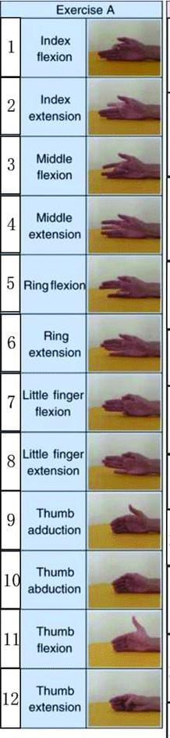
Some examples of 52 movements in Ninapro Datasets

Slide 12
MYO Armband Data set
MYO Armband dataset used in EMG, data is acquired from a device called MYO Armband which utilizes the electrical signals from the muscles in the forearm commonly known as EMG signal fused with motion data. This dataset is employed for instance in gesture recognition, prosthetic control and human-computer interface applications.
The MYO Armband has eight sensors which scan the signal of muscles through surface electromyography or EMG and has to be worn around the forearm. These sensors capture electrical signals associated with muscle contractions and give out real-time EMG signal.
The device acquires the EMG signal at a frequency that ranges normally from 200Hz to 500Hz, and it obtained the muscle activity while performing different gestures or movements
Example Use Cases: Controlling a Computer Interface: Applying the MYO Armband dataset to develop a system of controlling a computer or Smartphone with motions. Robotic Arm Control: Coming up with a prosthetic arm or a robot arm that can be operated with the help of the signals that are recorded from the surface of the skin by the MYO Armband. Gaming and VR: Improving game play and general usage of devices with a focus on gesture control with the MYO Armband.

Slide 13
Project plan
2024
Months
2024
Jul
Aug
Today
100%
Batch creation , Project selection and Guide Allocation
3 days
29 Jul - 31 Jul
100%
Consent form submission
3 days
30 Jul - 1 Aug
100%
Abstract form submission
5 days
1 Aug - 7 Aug
100%
Literature Review
10 days
8 Aug - 21 Aug
Literature Review
8 Aug - 21 Aug

Slide 14
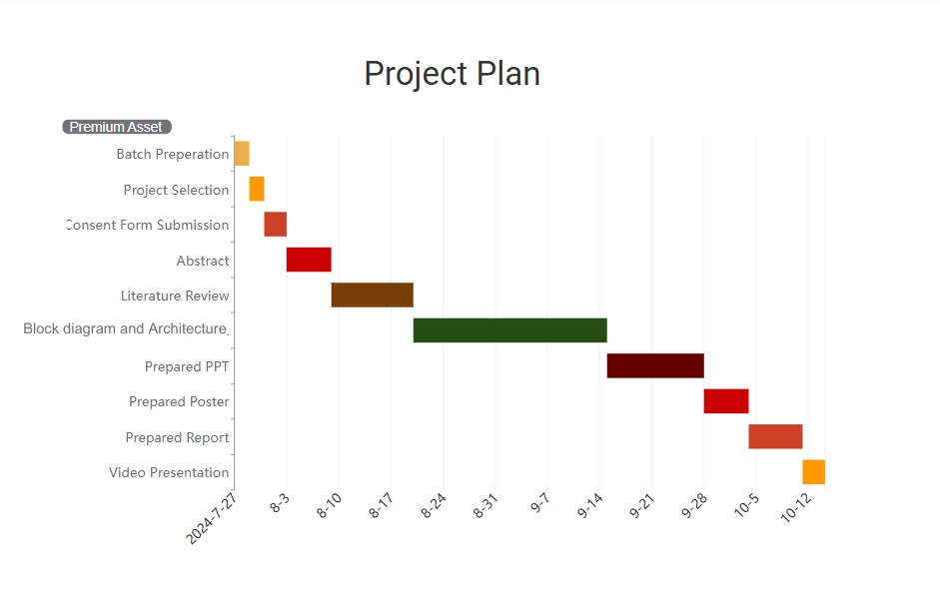

Slide 15
Analysis – 4W1H
Why: To develop an efficient control mechanism for software robots using hand gesture recognition based on surface EMG signals.
What: Classification of hand gestures using a CNN model to control software robots through muscle contractions detected via EMG sensors.
Where: This technology can be implemented in various fields such as prosthetics, human-machine interaction, virtual reality, and gaming
When: The research was conducted during the academic year 2021-2025, with different project phases covering literature review, model development, and testing
How: The project used surface EMG sensors to capture hand gestures and employed CNN for signal classification. A software robot is then controlled based on recognized gestures.
Refined Objective: To design an EMG-based hand gesture recognition system using CNN, aimed at controlling a software robot with high precision and minimal user training.

Slide 16
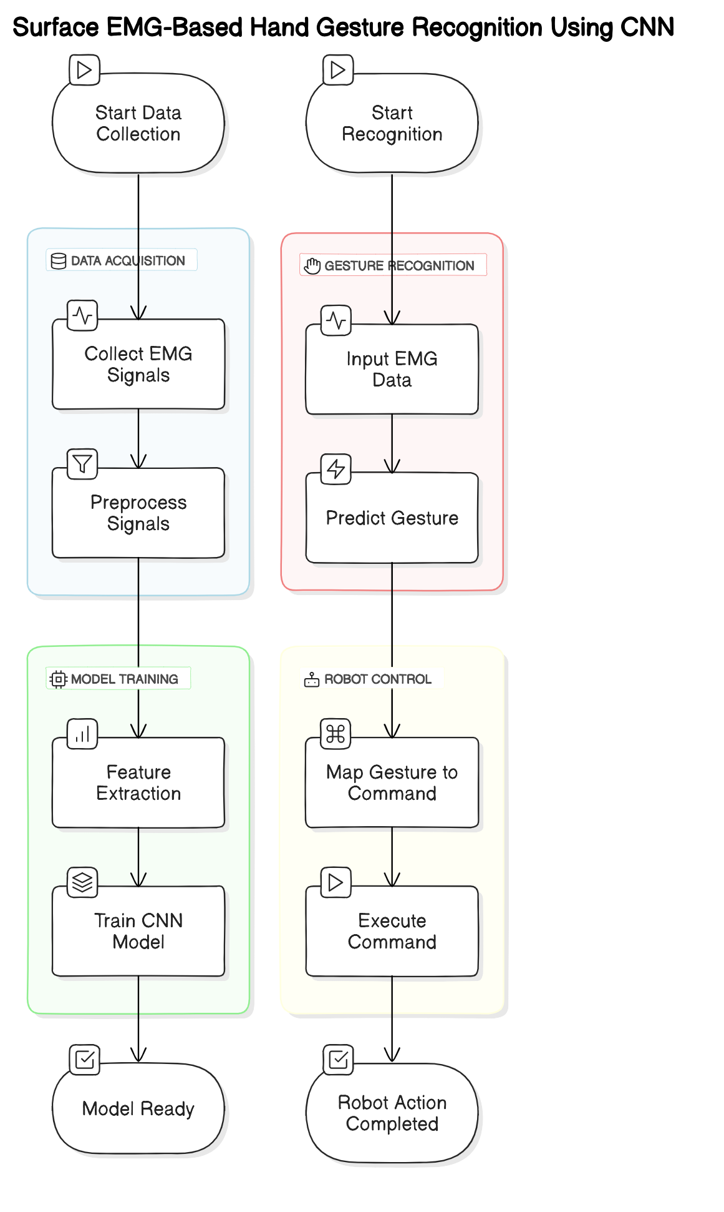
Block diagram

Slide 17
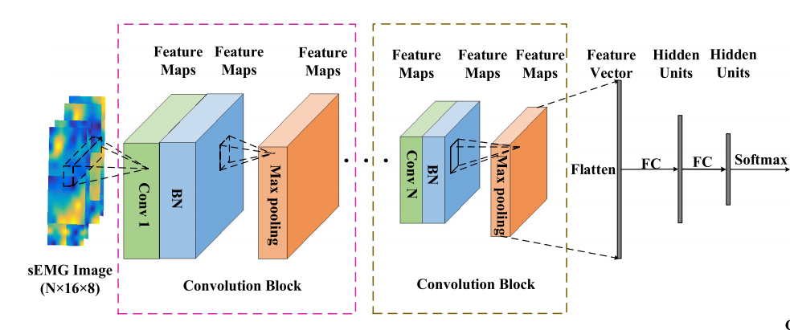
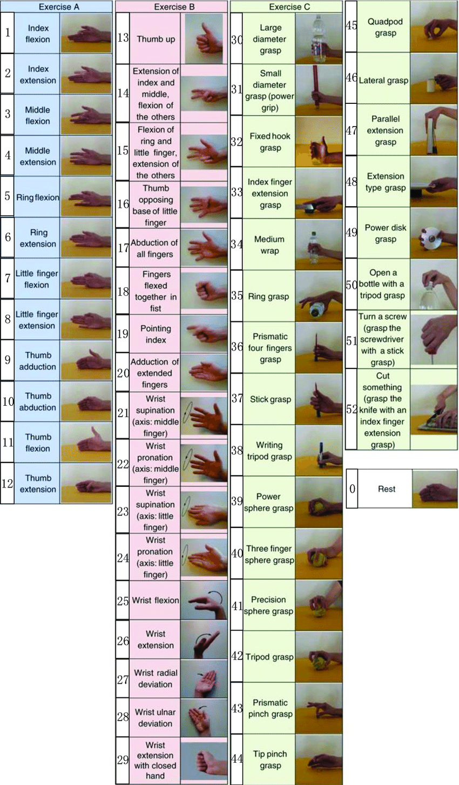
Architecture

Slide 18
Use Cases & Testing
Use Cases
Controlling a prosthetic arm using recognized hand gestures.
Real-time control of a virtual environment or gaming character using sEMG-based gestures.
Human-computer interaction through gesture-based commands.
Communication aid using gesture recognition for sign language translation.
Test Cases
Validate gesture recognition accuracy for different hand movements.
Test responsiveness of gesture-based control in real-time applications.
Assess classification accuracy with varying sensor placements and environmental conditions.

Slide 19
Implementation and Results – Iteration 1
Objective: Design a CNN model for gesture recognition of the hand. Implementation: Myo Armband was used to receive sEMG signals for 5 different hand gestures. A CNN comprising three convolution layers was designed for the automatic feature extraction. Classification of gestures was achieved using raw sEMG data. Achievements: 70% accuracy Failed to distinguish between nearly similar gestures such as pinch and point. Challenges: Model is electrode placement dependent, and Answer from Real time control is delayed.

Slide 20
Implementation and Results – Iteration 2
Objective: Develop a better CNN model with the attention mechanism for better feature extraction. Implementation: An attention layer is implemented on top to focus on the critical features of sEMG signals. The dataset was extended and augmented to improve the robustness of the model. Hyperparameters were tuned for better performance, and finally, Achievements: Accuracy increased up to 88%. Better distinction developed between two gestures that are very similar to each other. Classification latency reduced during classification, bettering the real control of the robot. Challenges: Model complexity increases due to the use of the attention mechanism; the model requires much more processing power.

Slide 21
Implementation and Results – Iteration 3 (Optional)
Objective: optimize the CNN to focus on the functionality of real-time control with adaptability towards multi-user. Implementation: Fine-tuned the model from the diversified dataset in order to be adaptable towards various users. Fine-tuned for lower computational load as it supports real-time performance. Expanded the gesture set for higher flexibility toward the provision of control. Achievements: Able to achieve 93% accuracy with real-time response that is faster.
Challenges: Future work will be on the hardware design to implement control of a software-designed robot.

Slide 22
Contribution
Team Progress and Movement:
Dataset creation using sEMG sensors.
Development of the CNN-based classification model.
Integration of gesture recognition with software robot control.
Individual Contribution
Avula Veera Siva Reddy:
Data acquisition and pre-processing.
Boya Rajesh:
CNN model design and implementation.
Bhanu Siva Sai Kumar M:
Integration and testing of gesture recognition with robot control

Slide 23
Conclusion & Future Work
Summary and Conclusion: We have shown the construction of an accurate hand gesture recognition model using surface EMG signals with CNN incorporating the attention mechanism for automatic feature extraction and classification. This ability of the model to pay attention to the parts of the EMG signals most relevant to its decision not only increases precision and reliability of gesture recognition but also minimizes the need to do extensive manual feature engineering, hence creating a much more efficient and scalable solution to this particular problem.
The model demonstrated good performance in classification of various hand gestures regardless of the position of the sensors and user-specific conditions, while CNN architecture with additional attention layers proved useful. It is guaranteed to achieve good accuracy in real-time applications. Therefore, it is well suited to control a software-designed robot by simple intuitive hand movements.
Future Work: Future work will be on the hardware design to implement control of a software-designed robot. More experiments with more sensors such as accelerometers to achieve better precision and the extension of the model to identify a larger variety of gestures would further improve system functionality. Testing the system under real-world conditions for long-term usability and building a generalized model for multiple users would be of great value as next steps.

Slide 24
THANK YOU

